Slide 1
Toward SDN for Tactical Edge Networks Y. Richard Yang Yale University

Slide 2

What is SDN?
Separation of data and control paths
Logically centralized control plan
…
Notes:
Risk: having a narrowly defined hammer and looking for nails

Slide 3


A More General View of SDN: Programmable Networks
Same deployed asset
Programmability to
provide more functions
utilize asset more efficiently

Slide 4
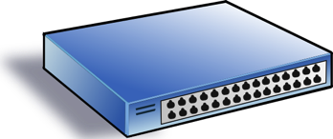
SDN Progress as Programmability Progress
Low-level Programming => High-level Programming
OpenFlow => P4/POF
Service/ Policy
Program Logic
Datapath Model/ Program
Datapath Model/ Program
Network State
Distributed Comp => Logically Centralized Comp

Slide 5
New Capabilities: High-level Network Programming Abstraction (Magellan)
Consider each pkt as a request
- Network as a single virtual server
- Network functions expressed in general purpose language
- Network functions (logically) invoked on each pkt, returning how net handles that request
- Intention returned to realization is opaque

Slide 6
Example Magellan Program
void f(Packet p) {
if ( !permit(p) ) p.route = null;
else {
EndpointProp sedp = hostTable(p.ipSrc());
EndpointProp dedp = hostTable(p.ipDst());
int rate = p.bitRate(); // protocol customizatiz.
QoSRoute qr = routingAlg(topology(), rate, sedp, dedp);
p.route = qr.route; p.rate = qr.rate;
}
}
QoSRoute routingAlg(Topology topo, int r, EndpointProp s, EndpointProp d) {
if ( allowedRate(s, d) < r ) // access control
r = allowedRate(s, d);
return QoSRouting(topo, s, d, r);
}
Notes:
relatively low rate, unreliable, nodes are highly mobile

Slide 7
Magellan Program to Command and Control
“Oracle” Program
DB
Compile
IR
Analyze&Optimize
Datapath Design
Code Gen
Offline
Rules
Batch Explorer
Net State
Update
onDemand Handler
Online
Network and Endhost Devices
Notes:
relatively low rate, unreliable, nodes are highly mobile

Slide 8
Challenges: What May a Tactical Network Break?
“Oracle” Program
DB
Compile
IR
Analyze&Optimize
Datapath Design
Code Gen
Offline
Rules
Batch Explorer
Net State
Update
onDemand Handler
Online
If Demand > Capacity => InControllability
Network and Endhost Devices
Notes:
relatively low rate, unreliable, nodes are highly mobile

Slide 9
From DC SDN to Tactical Edge SDN
Demand and capacity analysis and design for the network <-> controller channel
Increase capacity:
Controlled mobility
…
Decrease demand:
Degenerate to disconnected operation
Approximate/coarse-grained comput.
…

Slide 10
Summary
Protocol oblivious datapath and high-level SDN programming can lead to substantial flexibility and efficiency in network control and coordination
Key challenge in applying SDN to Tactical Edge is the demand vs capacity of the network-controller channel, where new programming abstractions need to be investigated

Slide 11
Backup Slides

Slide 12
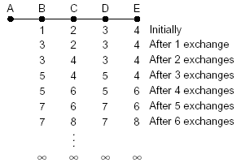
Why Logically Centralized Control?
Inconsistent state
Arrow’s Impossibility Theorem
Notes:
Inconsistent state is a key source of complexity

Slide 13
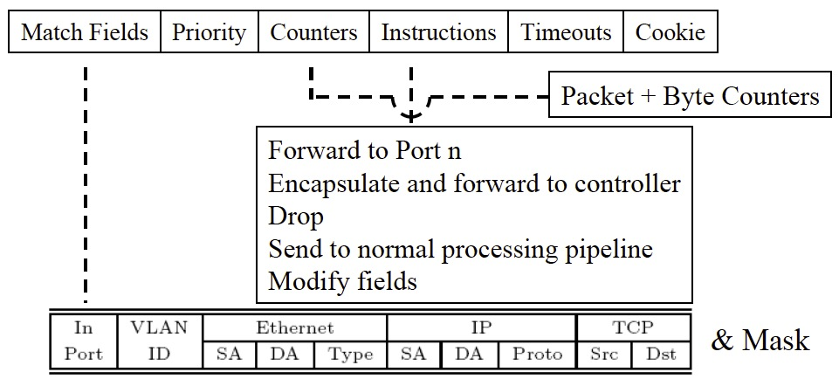
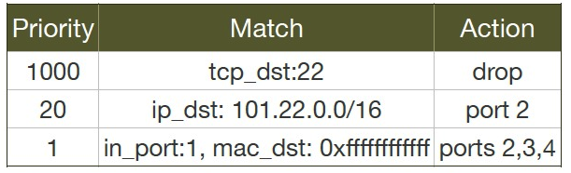
Data Path Abstraction (OpenFlow)

Slide 14
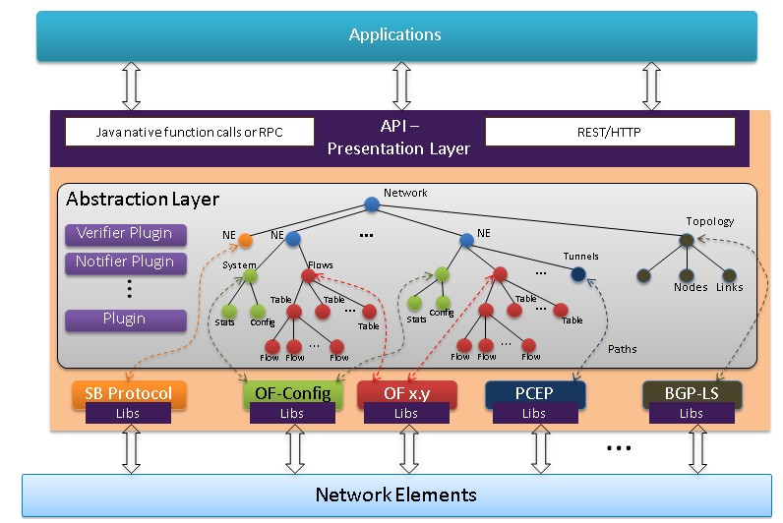
Data Store Abstraction (YANG)
https://wiki.opendaylight.org/view/OpenDaylight_Controller:Architectural_Framework

Slide 15
Network Forwarding as Caching Lookup
Central control function consists of a sequence of instructions I₁, I₂, …, I_{n}
Each instruction I is a mapping from input variable states to output variable states
InVar(I)₁ | InVar(I)₂ | InVar(I)₃ | OutVar(I)
1 | 1 | 1 | OutVar(I)=I(1,1,1)
…
…
InVar(I)1
I
OutVar(I)
InVar(I)2
InVar(I)3

